Slide 1
Shells 2
Georges Khazen

Slide 2
Variables
Variables types
In shell scripting, variables can generally be of two types:
Scalar: holds a single value
Array: holds multiple values

Slide 3
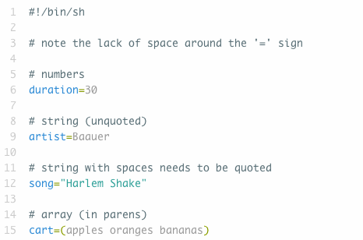
Declaring Variables

Slide 4
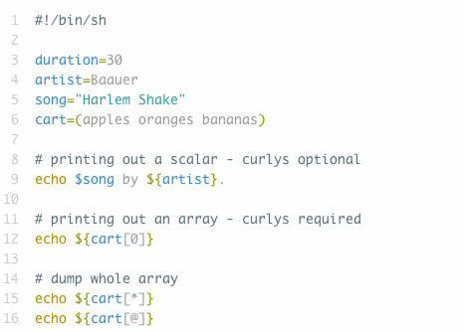
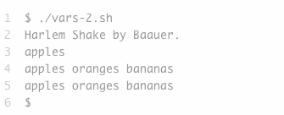
Referencing Variables

Slide 5
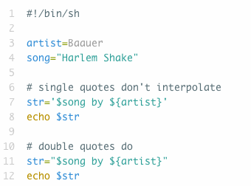
String Interpolation

Slide 6
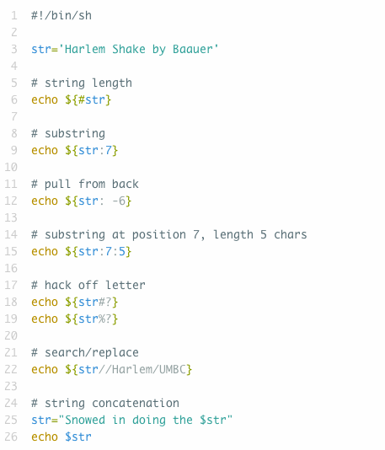
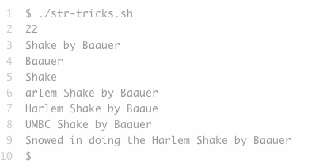
String Tricks

Slide 7
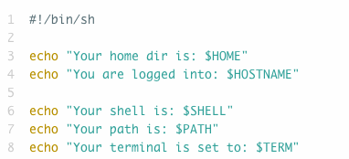
Environment Variables

Slide 8
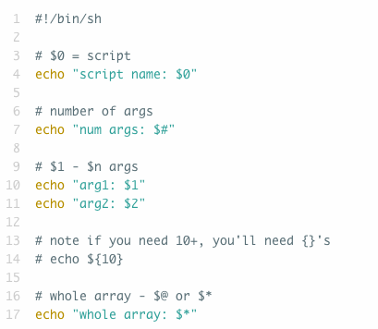
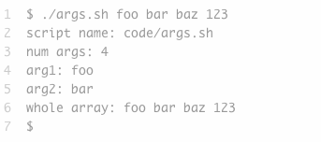
Command Line Arguments

Slide 9
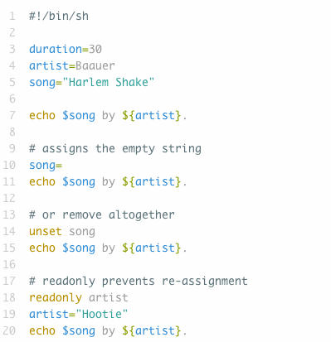
More VAriable tricks

Slide 10
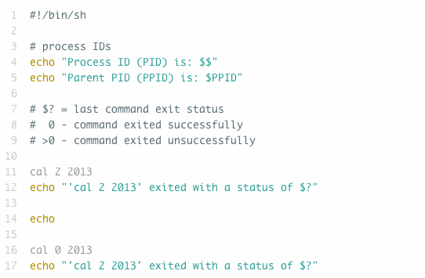
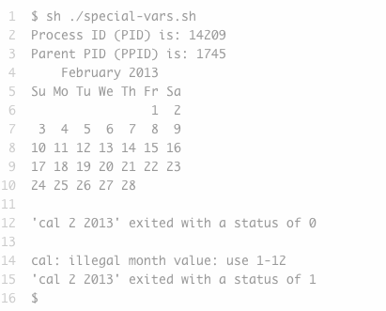
Special VariAbles

Slide 11
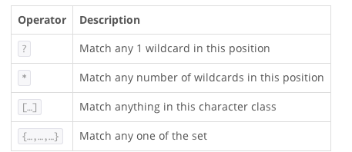
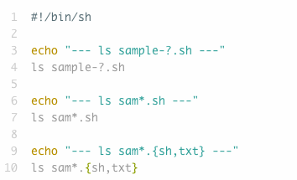
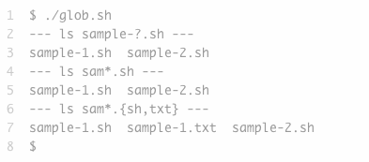
GLobbing
The shell supports globbing (also known as filename expansion), whereby the expression of meta-characters allow the shell to find all possible matches

Slide 12
Good PRactice
Creating your workspace, the scripts folder
The first step is to make a directory where your program files will go.
The shell knows to look in /bin and /usr/bin because there is a settings file (loaded when you login) which lists the places programs may be found.
This list of places is stored in system variable $PATH
Type set on the terminal to look at other environment variables

Slide 13
Good PRactice
Editing your .bash_profile settings file
You can permanently modify $PATH so it always include your new scripts directory.
This can be done by modifying a hidden file in your home directory called .bash_profile
This file is also a script file, and contains a list of commands that are automatically executed when you login.
First, make sure you are in your home directory
Type emacs/nano .bash_profile
Type export PATH=”$PATH:$HOME/Desktop/scripts”
There must be no spaces before or after the equal sign

Slide 14
Good PRactice
The previous command sets PATH to a combination of its old value plus a colon(:), plus the absolute location of your scripts directory.
Make sure the scripts you wrote is executable
Type ls -l
Based on the listed permissions you can check you have the permission to read, write, or execute the file
the r’s indicate read permission
the w’s indicate write permission
the x’s indicate execute permission
These are grouped in order of who can they apply:
use, group members, and all other users.

Slide 15
Good PRactice
The chmod command
chmod u+x scriptfile.sh
u+x tells the shell, “for the main user/owber of this file, add executable permissions”
You can subtract permissions using the minus sign.
chmod o-x scriptfile.sh
Make sure not to change your own permission to modify a file.

Slide 16
Streams & Redirection
Streams
There are three primary streams:
stdin: this is where a program gets its input from
stdout: this is where a program writes standard output
stderr: this is where a program writes exceptional output
Redirection
< source :this indicates read from source
> dest :this indicates write to dest
>> dest :this indicates append to dest

Slide 17
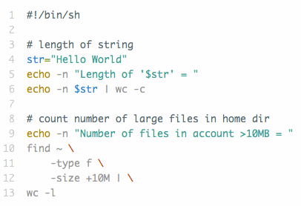
Pipes in a script

Slide 18
tee command
The tee command splits stdout into 2 streams, one continues on stdout, the other goes to a file.
Particularly useful if you want to see the results of something now and save it for later reference as well
try ls -l | tee fileList.txt

Slide 19
xargs command
The xargs command is used to invoke commands with command line arguments that are derived from input on stdin
Particularly useful if you want to run the same command or script on multiple of files
ls s* | xargs wc -c

Slide 20
Control structures
The test command tests a conditional expression.
It can be used in two forms.
Explicitly
test expression
OR Using brackets (WHITE SPACE IS IMPORTANT)
[ expression ]

Slide 21
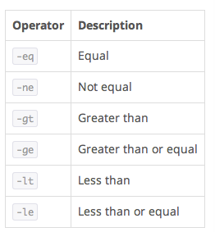
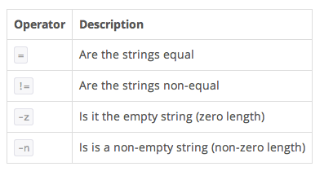
Control structures
Numerical (scalar) Operators
String Operators

Slide 22
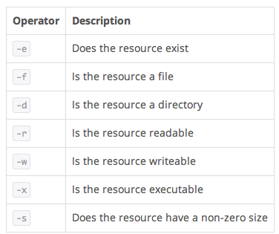
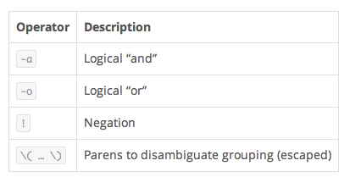
Control structures
Files Operators
Logical Operators

Slide 23
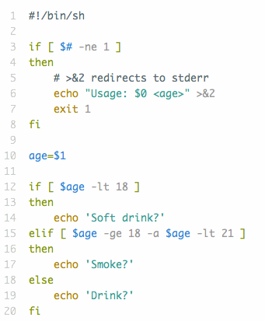
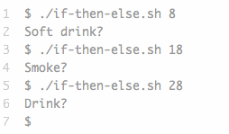
if/then/else

Slide 24
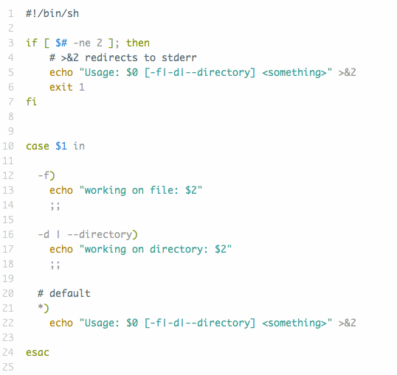
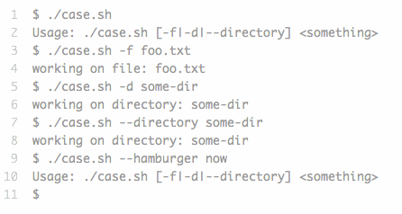
SWITCH

Slide 25
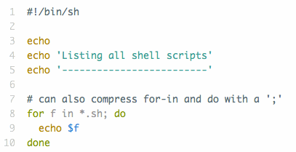
For loop
You can also use globbing to get a collection of files

Slide 26
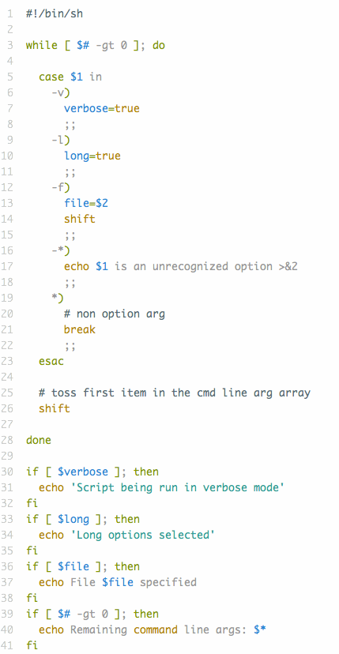
While Loop

Slide 27
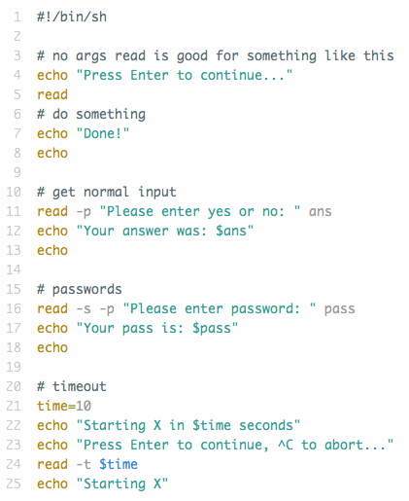
Input/Output
The read command is used to get input from a user

Slide 28
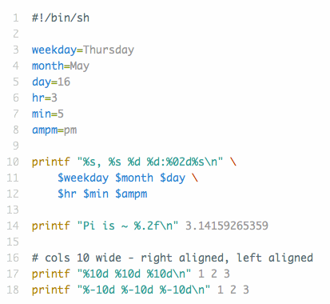
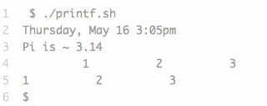
Printf
The printf command will print out on the screen (stdout)

Slide 29
Source
The source command reads the commands from a specified file and executes them in the current shell.
This is used often in shell initialization scripts to load in other scripts for evaluation

Slide 30
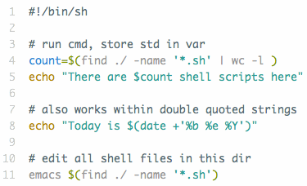
Command substitution
Command substitution allows you to run a command inline and capture the output of the process.

Slide 31
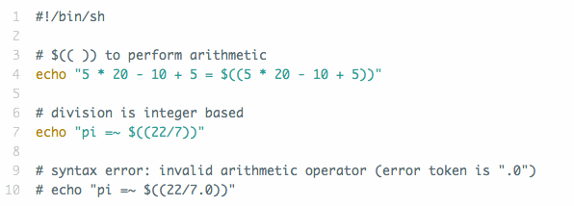
Arithmetic
Simple “integer: arithmetic can be done via expr and
$((...)) commands
If you need to deal with floating points (decimal), the bc command can be used
2185727

Slide 32
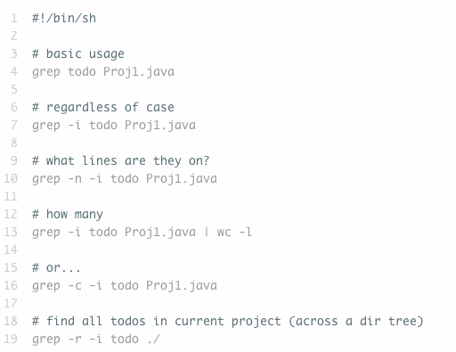
grep, SEd & AWK
grep is command used to find matches in files

Slide 33
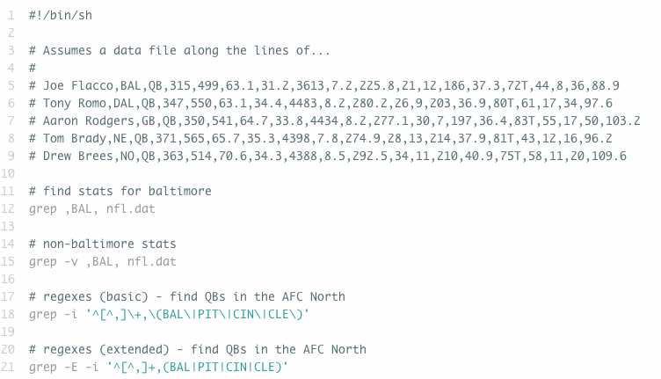
grep, SEd & AWK
grep is command used to find matches in files

Slide 34
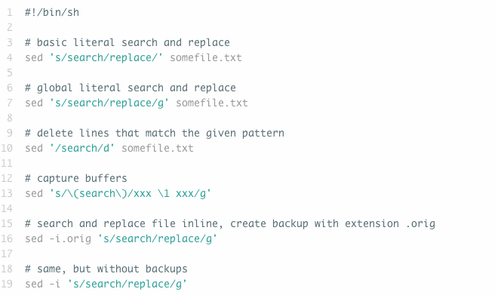
grep, SEd & AWK
sed is a stream editor command that allows you to perform numerous operations against streams in input

Slide 35
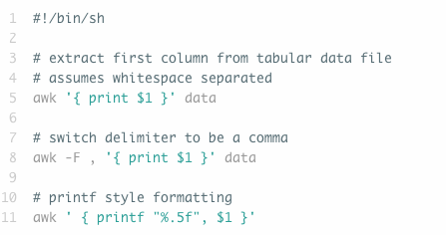
grep, SEd & AWK
awk command is a full blown processing and scanning language

Slide 36
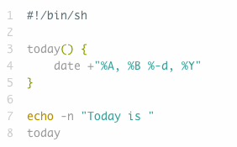
Functions
Basic Function
No keyword used to declare function
Denoted by (){}
No return types
Function invocation does not have parens

Slide 37
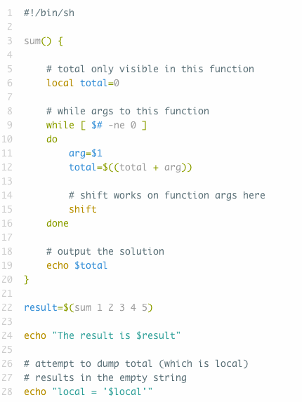
Functions
Passing arguments to functions
Args passed via space separating (not parens)
$# and $1…$n refer to function arguments when inside a function
Local & Global Variables

